Slide 1







Interacting with Tiny bit
IR Control
Yahboom

Slide 2









Contents
Preparation
Learning goal
Search for blocks
Combine blocks
Experimental phenomena
Yahboom

Slide 3

Preparation
The position of the Infrared receiver motor on the robot car
Learn how to use infrared remote controller
!!!Note:
1. This experiment needs to be done indoors to reduce the interference of sunlight on the infrared receiver.
2. Since there are always some problems with the infrared expansion package, and Microbit has not solved this problem.
Case1: If you are using the Microbit V1 board, please use the hex file provided by us directly, and do not open the hex file in the MakeCode graphical programming interface, otherwise it will cause some errors, and the infrared remote control function cannot be realized.
Case2: If you are using a Microbit V2 board, you can use this expansion pack. https://github.com/YahboomTechnology/Yahboom_IR_V2
Yahboom

Slide 4
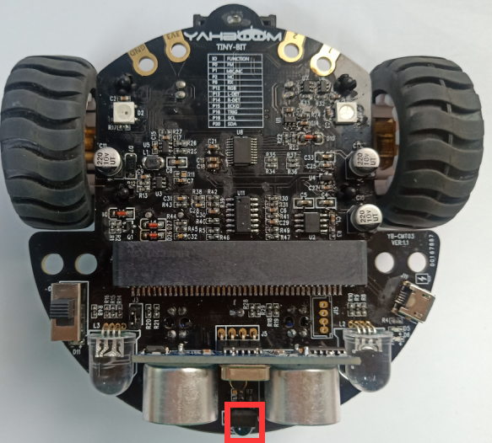
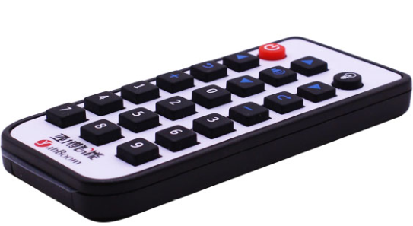
Preparation
As shown on the left figure, the infrared receiver on the robot circled by the red wire frame.
As shown on the right figure, infrared remote controller.
Yahboom

Slide 5
Preparation
Programming method:
Mode 1 online programming: First, we need to connect the micro:bit to the computer by USB cable. The computer will pop up a USB flash drive and click on the URL in the USB flash drive: http://microbit.org/ to enter the programming interface. Add the Yahboom package: https://github.com/YahboomTechnology/Tiny-bitLib and https://github.com/YahboomTechnology/Yahboom_IR_V2 to program.
Mode 2 offline programming: We need to open the offline programming software. After the installation is complete, enter the programming interface, click【New Project】, add Yahboom package:https://github.com/YahboomTechnology/Tiny-bitLib and https://github.com/YahboomTechnology/Yahboom_IR_V2 , you can program.
Yahboom

Slide 6
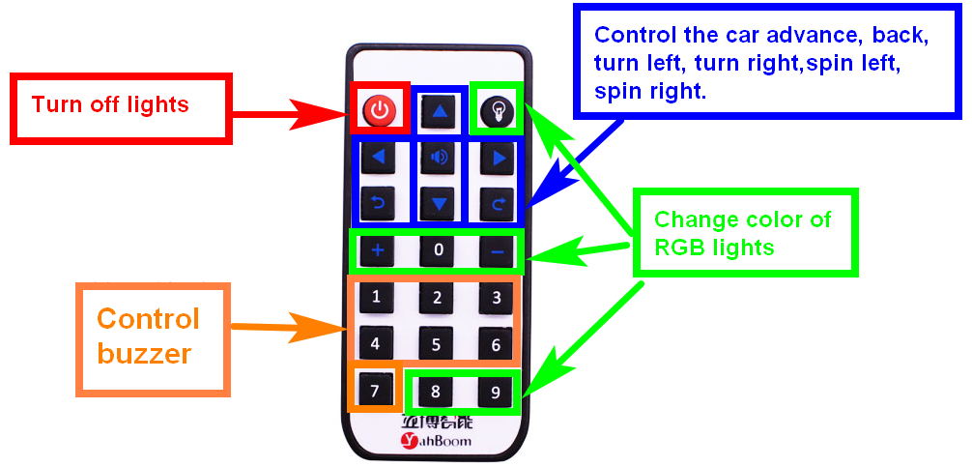
Learning goal
1.Learn about using infrared remote control graphically programming blocks
2.The following functions are controlled by the infrared remote controller.
Yahboom

Slide 7

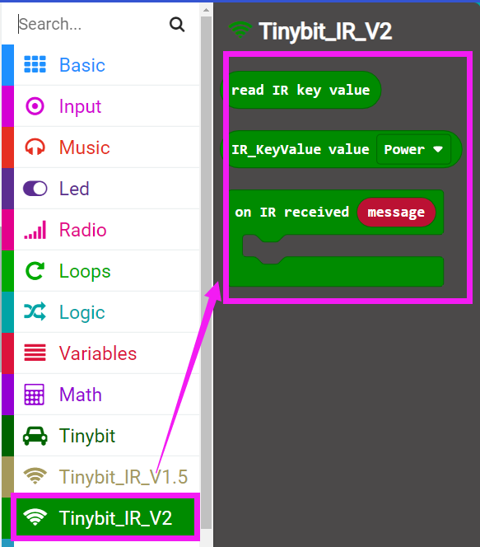
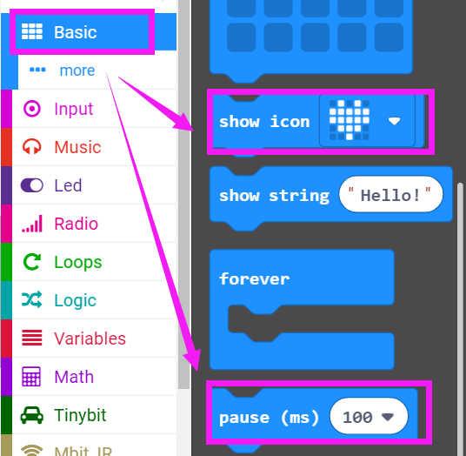
Search for block
The following is the location of the building blocks required for this programming.
Yahboom

Slide 8
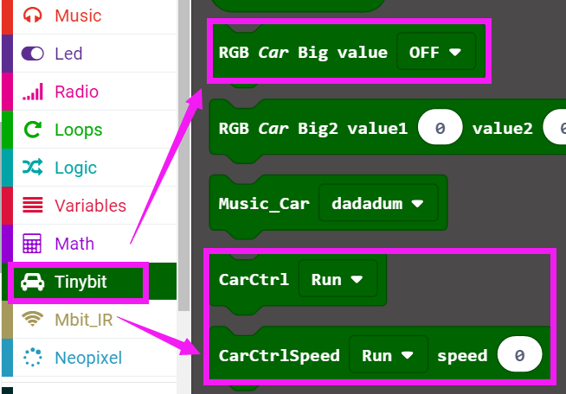
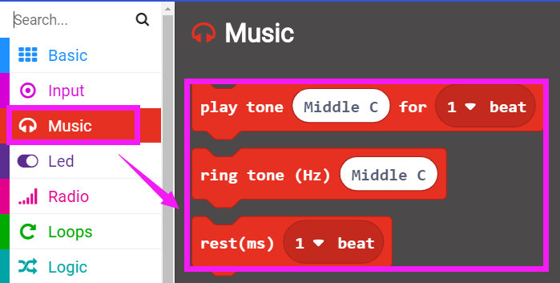
Search for block
Yahboom

Slide 9
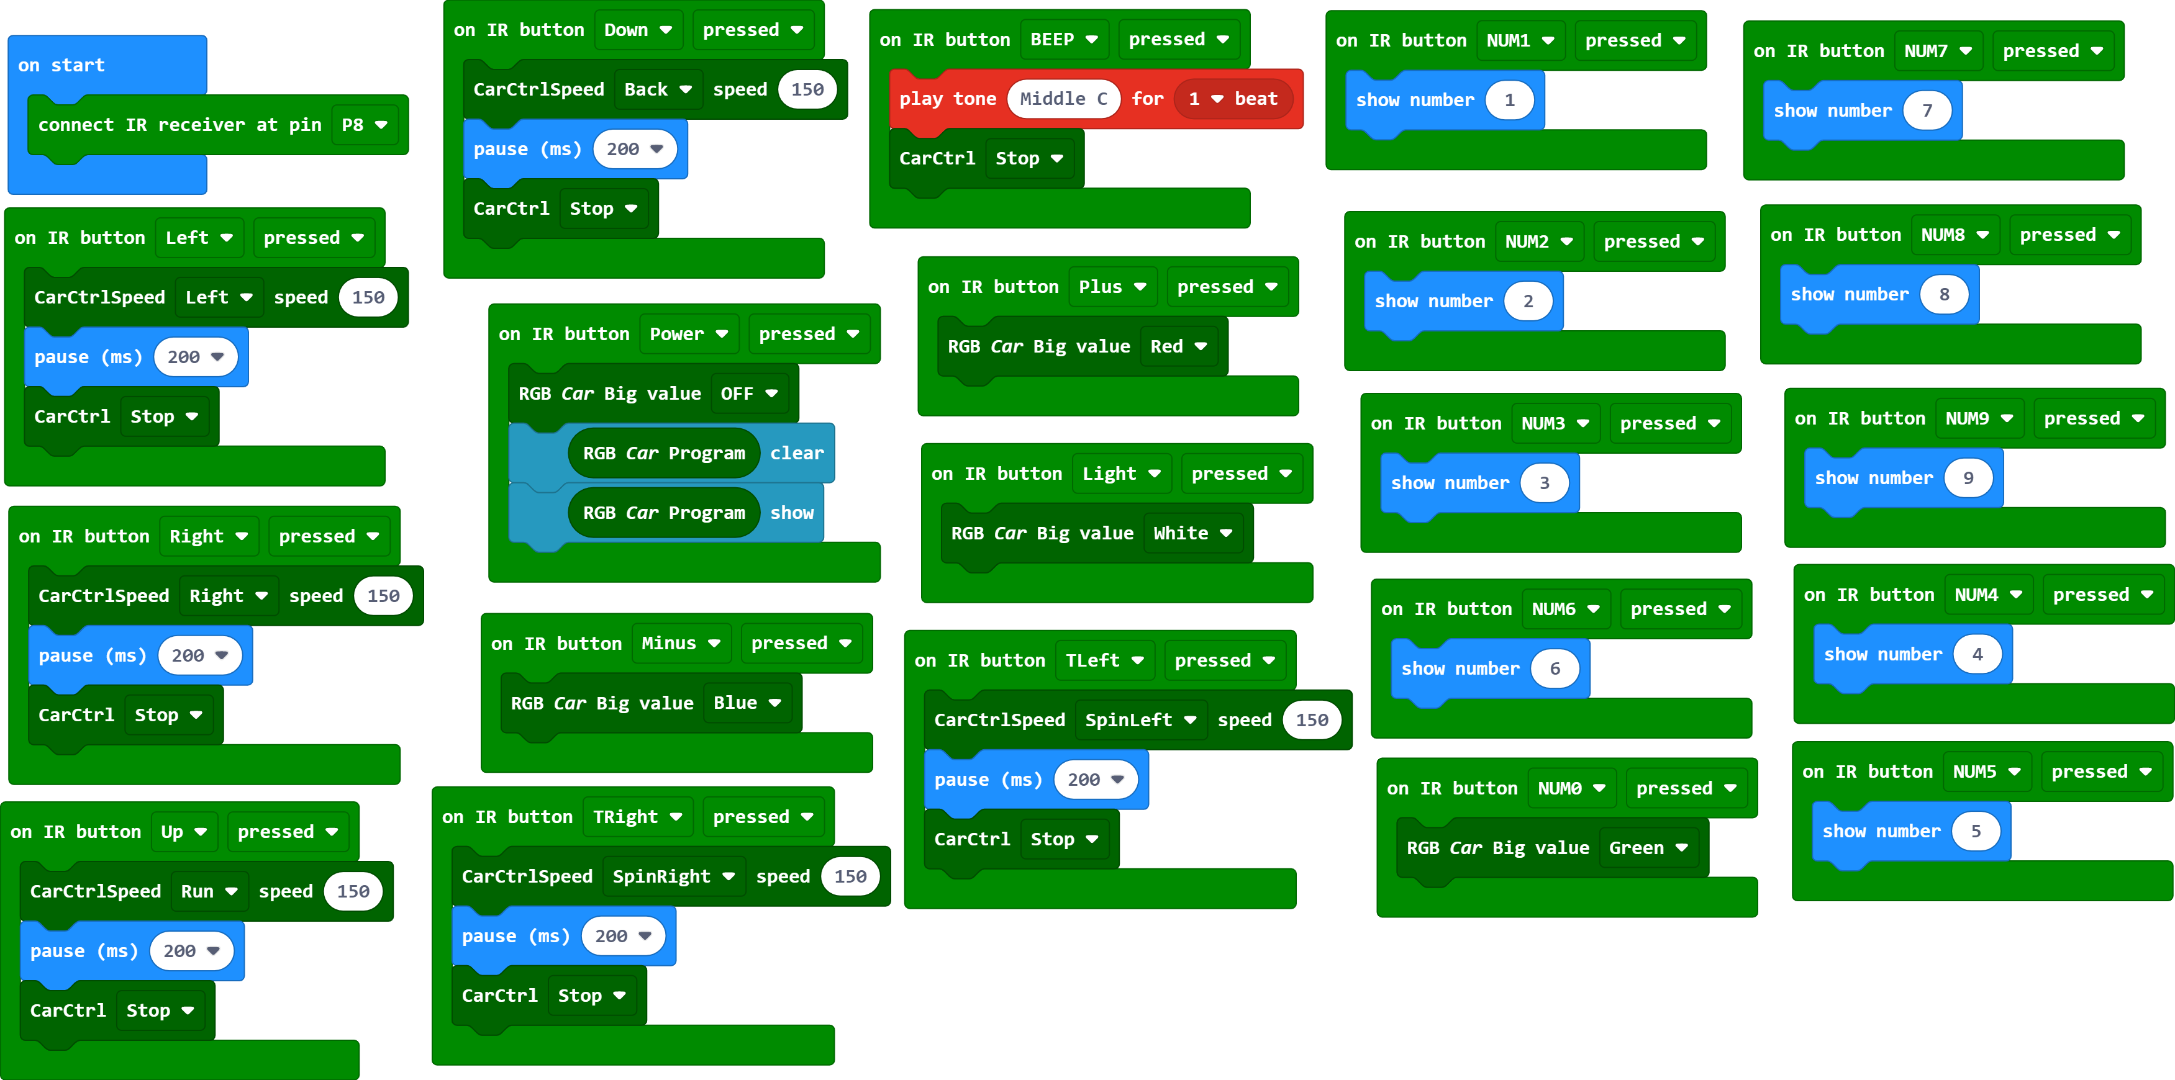
Combine block
The summary program is shown below:
Yahboom

Slide 10
Experimental phenomena
After the program is downloaded, we can control the robot car by infrared remote controller.
!!!Note:
This experiment needs to be done indoors to reduce the interference of sunlight on the infrared receiver.
Yahboom

Slide 11
Inspire Creativity Embrace Innovation
Thank you!!!

